Slide 1
Firewall Simulation
by
Ken Williams

Slide 2
Firewall Simulation
The simulation allows participants to configure their own simulated firewalls using Cisco-like syntax.
Participants can take benign or malicious actions against other players to score points.
The interactive and competitive nature of the simulation helps students learn about firewalls while having fun.

Slide 3
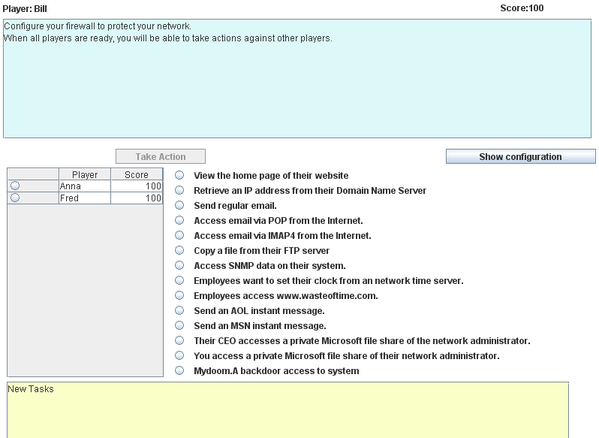

Slide 4
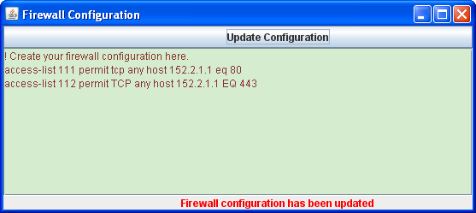
Firewall Configuration Window

Slide 5
Simulation Process
When you first start, you must enter your name to identify yourself to other participants.
Configure your firewall to allow needed services while preventing attacks.
Once the actions are enabled, you can take actions against other players.
Reconfigure your firewall whenever necessary to correct problems.
New tasks will appear that may require you to reconfigure your firewall.

Slide 6
Configuration Syntax
access-list number {permit | deny}
[protocol]
{any | ipaddr mask | host ipaddr}
{any | ipaddr mask | host ipaddr}
[operator port | established] [log]
The entire access-list command must be written on one line.

Slide 7
Address Formats
You can specify a source or destination IP address in three different formats:
any – all addresses match
host 12.34.56.78 – This address matches one specific computer with the given address
IPaddress mask – This address is compared to the given IP address ignoring the bits that are one in the mask.

Slide 8
Example
This permits any computer on the Internet to connect to the computer whose IP address is 152.8.1.1 using the TCP protocol and port 443.
access-list 111 permit tcp any host 152.8.1.1 eq 443

Slide 9
Example
This prevents any UDP traffic from reaching computers in 152.8.100.X subdomain
access-list 112 deny udp any
152.8.100.0 0.0.0.255
Note: access-list statements must be written on one line.

Slide 10
Order is Important
When a packet arrives at your firewall, it will be compared with each access-list statement in the order they appear.
The first statement that applies to that packet determines if it is permitted or denied.
For incoming traffic, there is an implicit deny everything at the end of the access-lists.
For outgoing traffic, there is an implicit permit everything at the end of the access-lists.

Slide 11
Firewall Configuration
The firewall configuration window should contain all of your access-list commands.
Some real firewalls allow you to input only one line at a time or upload a file of commands
The simulator assumes the file upload concept

Slide 12
Your Simulated Network
There is a link on the webpage to a diagram of the simulated network showing the computers and their IP addresses.
Your domain has the Internet address of 152.8.0.0/16

Slide 13
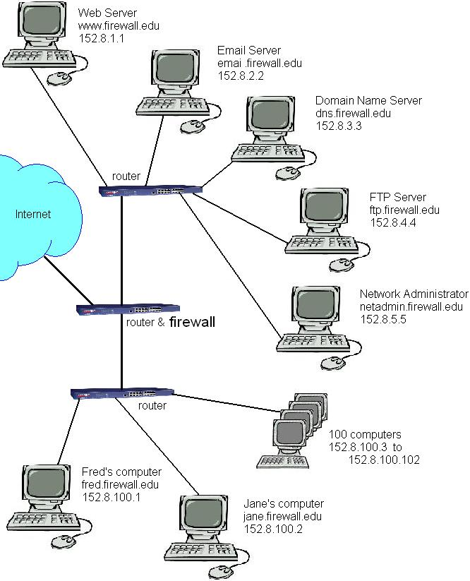

Slide 14
Coming and Going
The access-list commands specify source and destination addresses.
If the source address starts with 152.8, then the traffic is going out from your network to the Internet.
If the source is any other address, then the traffic is coming into your network.

Slide 15
Needed Services
Access by the public to your web site
Email from other email servers using SMTP
Domain Name Server access

Slide 16
Useful Port Numbers
21 FTP
23 Telnet
25 Simple Mail Transport Protocol
53 Domain Name Servers
80 HTTP
110 POP3 client email
123 Network Time Protocol
137-139 Microsoft NETBIOS
143 IMAP4 client email
161 Simple Network Maintenance Protocol
443 HTTPS
445 Windows File Sharing
1863 MSN Instant messaging
3389 Windows Remote Desktop Protocol
5190 AOL instant messenger

Slide 17
Simulator System Requirements
The simulation is designed to run on regular PCs with no special networking restrictions.
Participants need a Java enabled browser.
Runs on Windows, Linux, etc.
Safe to run in a public environment.
The web server has to run the central monitor program.
UDP port 49876 has to be open on real firewalls.

Slide 18
Start the Simulation
In the UNCC lab, boot the required virtual machine.
Open http://172.16.1.229/Simulation.html

